Slide 1
April 2024
EE381V Statistical Machine Learning
Community Segmentation
Babuji Periasubbramaniam

Slide 2

Project Objective
Perform RFM analysis and apply unsupervised learning techniques, specifically K-Means++ clustering, to distinguish different groups within a community.
The project aims to identify meaningful clusters based on socio-economic indicators without prior labels in the dataset.
The goal is to provide insights into community structures and characteristics

Slide 3
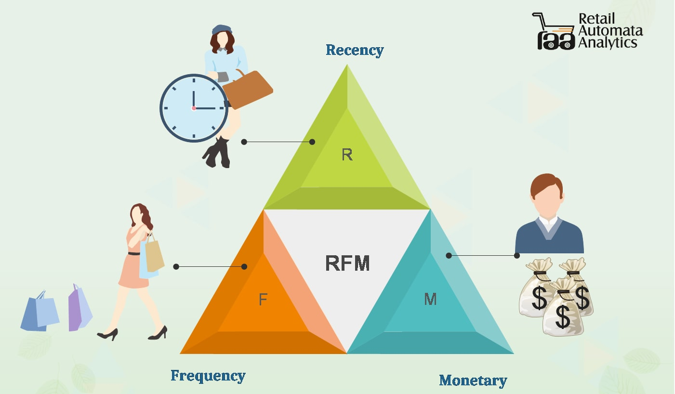
RFM analysis
Recency: How recently a customer made a purchase.
Frequency: How often a customer makes a purchase.
Monetary: How much money a customer spends.
RFM (Recency, Frequency, Monetary) analysis is a marketing technique used to segment customers based on their transaction history.

Slide 4
K-Means++ Clustering
K-means clustering is a popular unsupervised machine learning algorithm used for clustering data points into groups based on similarity.
It works by selecting the initial centroids based on a probabilistic approach that favors selecting centroids that are far away from each other.
The initialization process in Kmeans++ significantly reduces the likelihood of converging to suboptimal solutions and improves the convergence speed of the algorithm.
By selecting more representative initial centroids, K-means++ often leads to better overall clustering results compared to the traditional K-means algorithm.

Slide 5
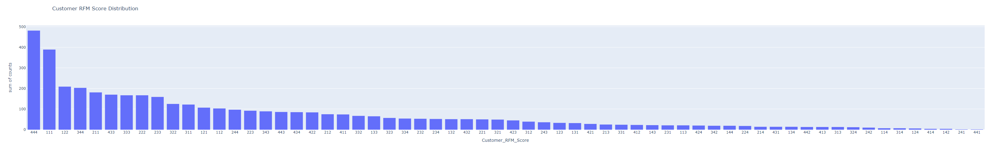
Customer RFM Score Distribution

Slide 6
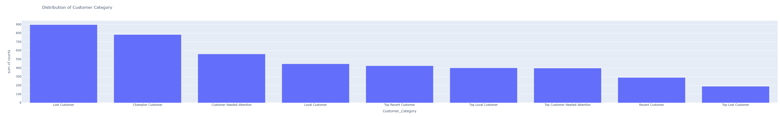
Distribution of Customer Category

Slide 7
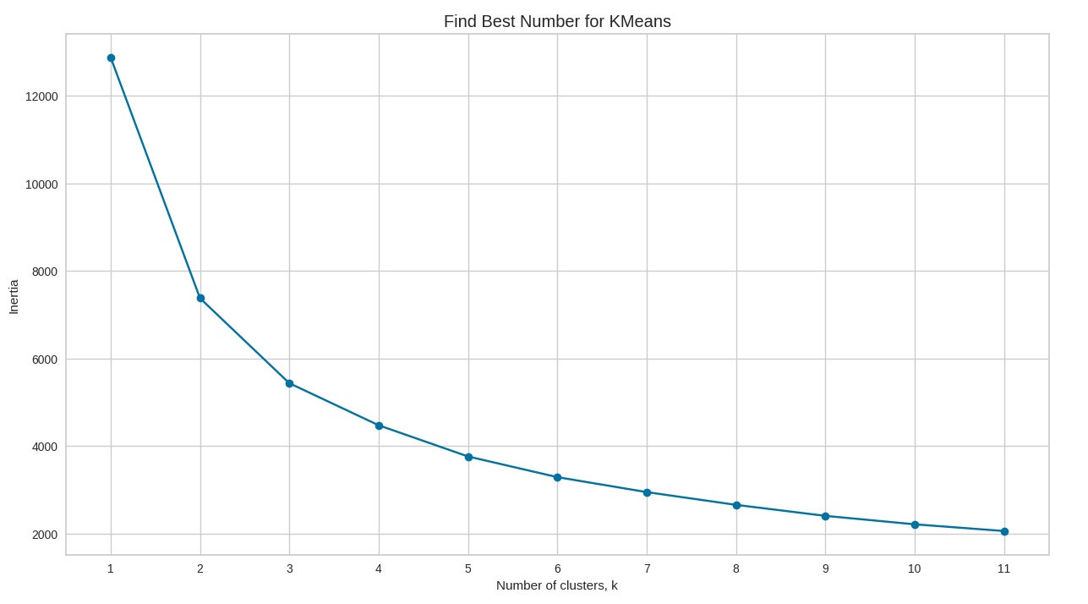
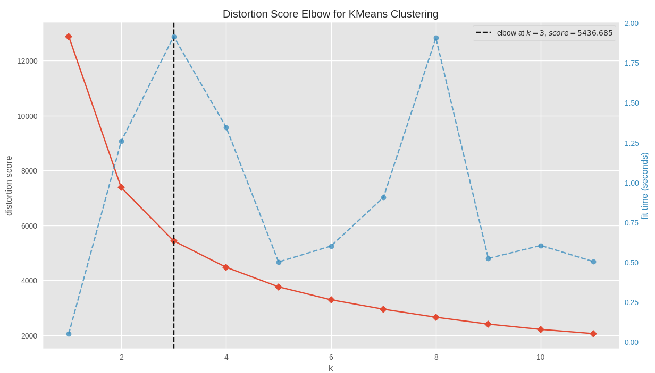
K-Means++ Clustering
Visualizer plot - KElbowVisualizer fits the model for a range of RFM clusters values from 1 to 12; parameter k=(1, 12).
Model is fit with 3 clusters and "elbow" in the graph - The optimal number since we created our synthetic dataset with 3 clusters of points.
Recommendation to apply 3 n_clusters for modeling according to the Elbow method.

Slide 8
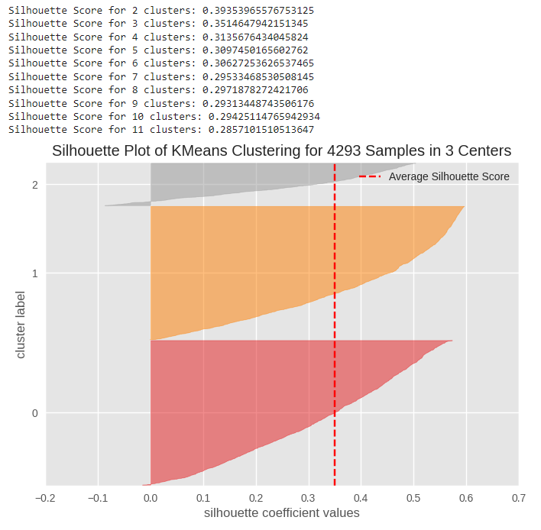
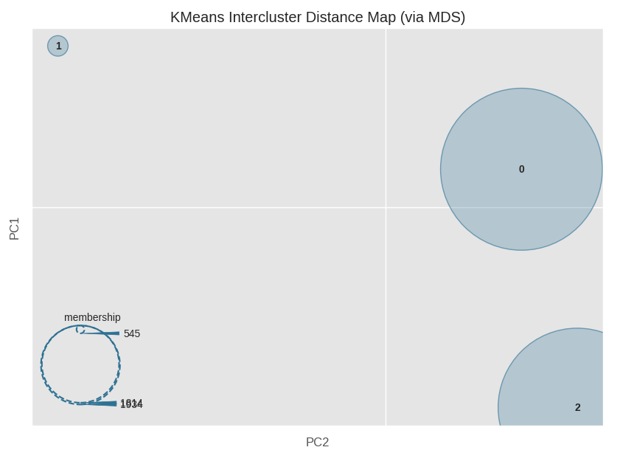
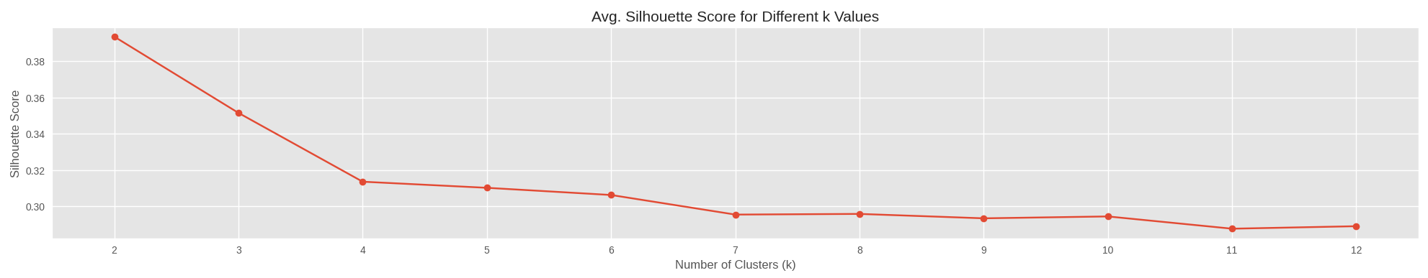
Silhouette Score and Distance Map

Slide 9
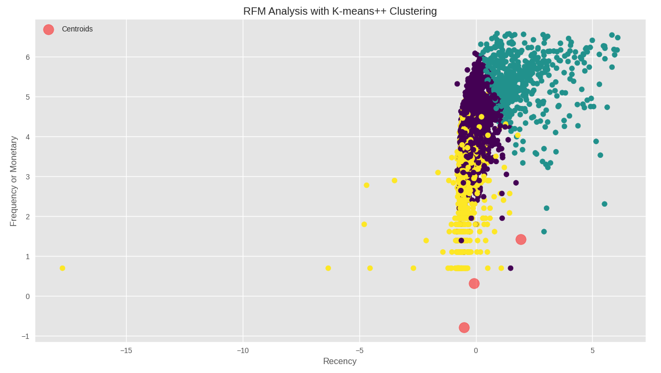
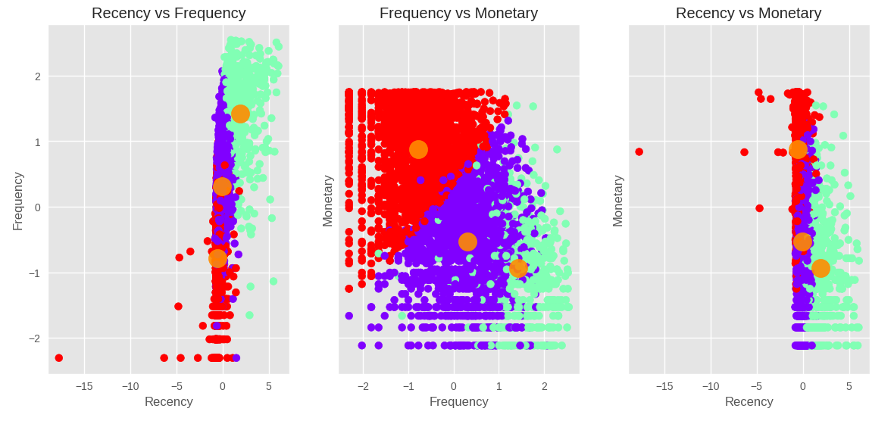
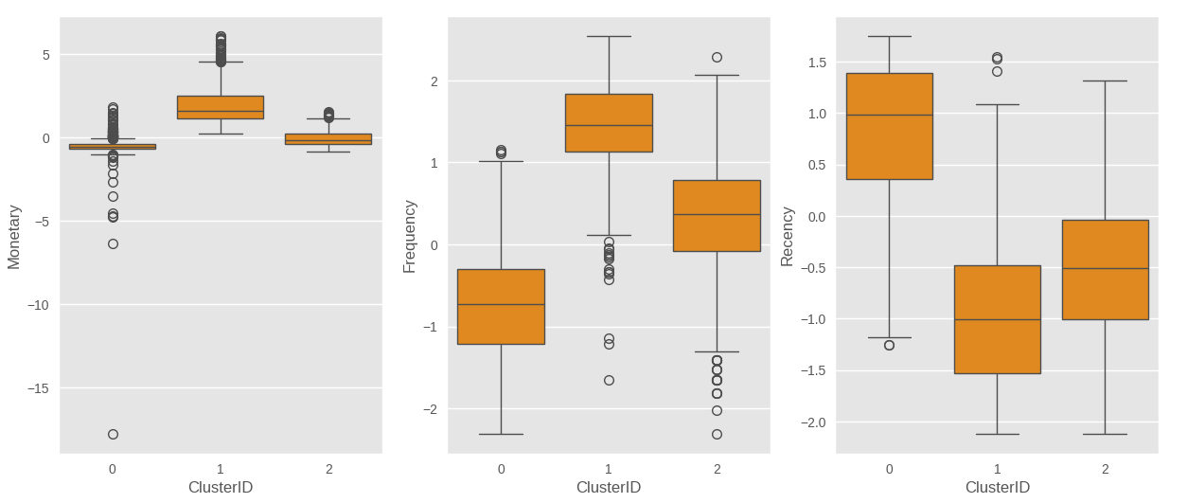
Cluster Visualization

Slide 10
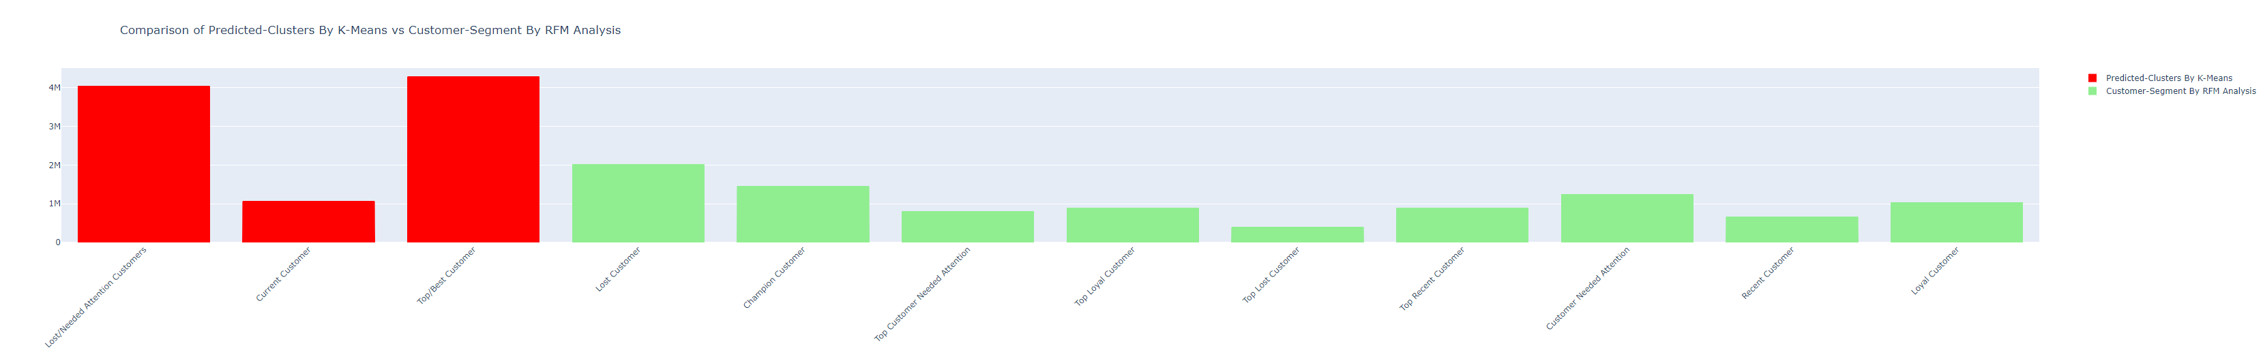
Predicted Clusters By K-Means vs Customer-Segment By RFM Analysis

Slide 11
Babuji Periasubbramaniam
cockrell.utexas.edu
THANK YOU.

Slide 12


